Slide 1



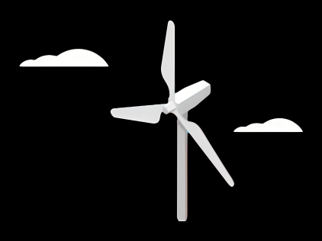
Gearbox, Brake, Coupling
Group Members :
Nehang Jitendra Joshi
Santo Mazumder
Md Razaul Karim Rahat
Arham Memon
Week number : 02
Date: 30/09/2025
Supervisor: Prof. Peter Quell

Slide 2
Agenda for 2nd week
Team Distibution
Concept of drive train choice
Basic idea about brake system
Insight about the coupling
Coordinate with internal group--
Rotor hub and Bearing Team (Mechanical Input)
Electrical Drivetrain Team (Mechanical Output)
Chapter | Responsible person
Introduction | All team members
Project order | All team members
Gearbox | Nehang + Arham
Rotor brake | Rahat
Coupling | Santo

Slide 3
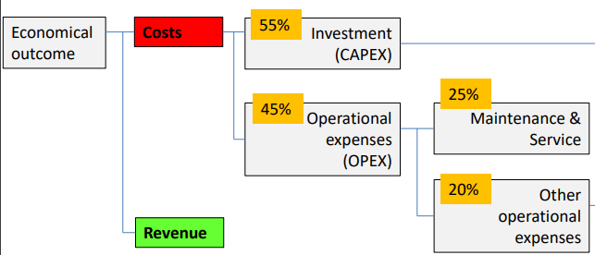
Drive train and Gearbox syestem
Main Objective:
Selection table for different drive train concept
Details of 3-Point suspension concept
Basic information about gearbox system
Source-Mechanical Drivetrains Prof. Peter Quell / University of Applied Sciences Kiel

Slide 4
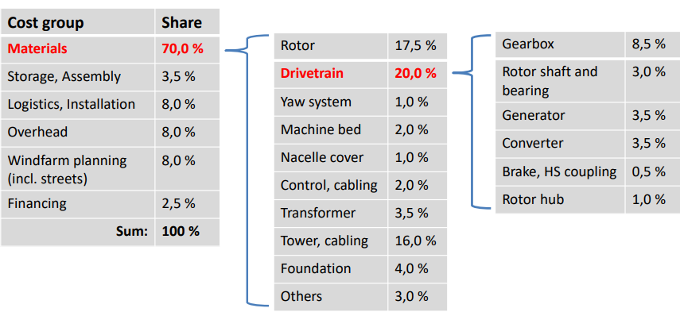
Drive train for CAPEX and OPEX
Source-Mechanical Drivetrains Prof. Peter Quell / University of Applied Sciences Kiel

Slide 5
Criteria of drive train | 4Point suspension Modular | 3point suspension Semi-integrated | Integrated | hybrid | Direct drive | Max and Min
Low capex | 1 | 3 | 2 | 1 | 1 | 3 and 1
High serviceability | 3 | 3 | 1 | 1 | 1 | 3 and 1
Easy to assemble | 2 | 3 | 3 | 3 | 2 | 3 and 2
Availability of spear parts | 3 | 3 | 1 | 1 | 1 | 3 and 1
Light weight | 1 | 2 | 3 | 2 | 3 | 3 and 2
Transport | 3 | 3 | 1 | 1 | 2 | 3 and 1
Reliability | 1 | 2 | 2 | 2 | 3 | 3 and 1

Slide 6
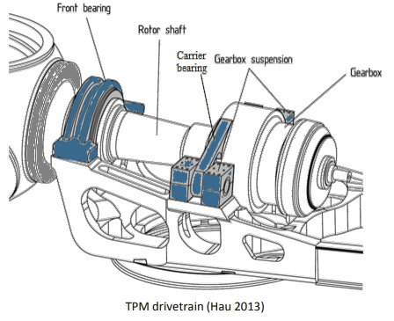
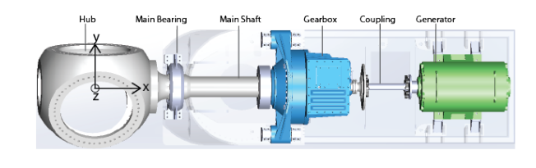
3-Point suspension
Source-Y. Guo, National Renewable Energy Laboratory, 15013 Denver West Parkway, Golden, CO 80401.

Slide 7
3-Point suspension
Pros-
Most cost-effective concept, Elimination of the separated 2nd rotor bearing.
light weight
Shorter drivetrain
No risks of tensing the drivetrain during assembly
Cons-
-Rotor loads (forces and moments) are transferred through the housing of the gearbox into the machine bed. May damage the gearbox in case of poor design.
-Elastic coupling between gearbox and generator
Environmental conditions
Extreme temperatures
High humidity
Sand and Dust (deserts)
High number of lightning strikes
Earthquakes
Operational conditions
Long maintenance intervals
High dynamics (e.g. tower deflection)
Low stiffness of drive train foundation (machine bed)

Slide 8
Gearbox system
Main Objective:
Types of gears
Pros and cons of each gear via table
Final recommendation

Slide 9
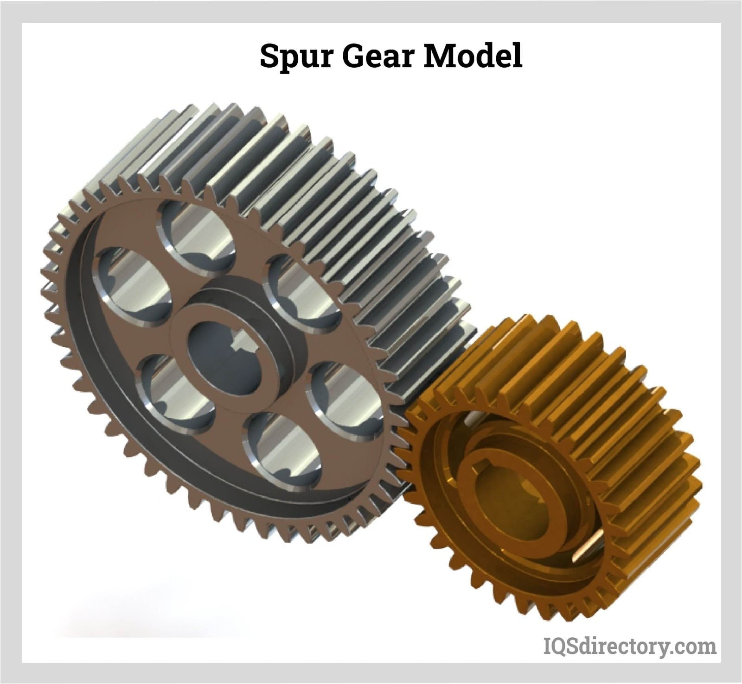
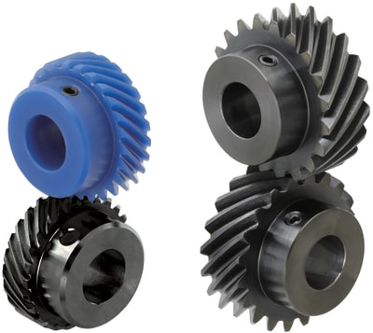
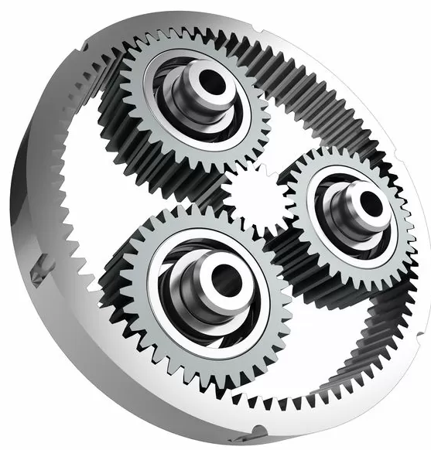
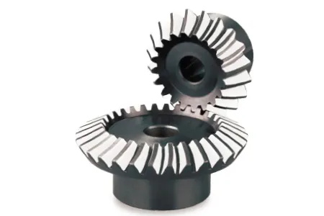
Gearbox system
Source-IQS Directory
Source-Helical gear by MISUMI Manufactures
Source- Planetary System gears by SMC
Manufactures
Source-Beval gear by KHK Manufactures

Slide 10
Gearbox system
Criteria of gears | Spur gear | Beval gear | Helical gear | Planetary gear
Design | 3 | 2 | 2 | 1
Manufacturing | 3 | 1 | 1 | 1
Space requirement | 1 | 2 | 2 | 3
Weight | 1 | 1 | 1 | 3
Transmission efficiency | 2 | 3 | 2 | 3
Reliable | 3 | 1 | 2 | 2
Cost | 2 | 1 | 2 | 1

Slide 11
Rotor Brake
Main Objective:
Types of brake
Pros and cons for each brake system via table
Final recommendation
Rotor Brake
Yaw Brake
Aerodynamic Brake
Electrical Brake

Slide 12
Rotor Brake
Criteria of rotor brake | Fixed caliper | Floating caliper
Design | 3 | 1
Manufacturing | 2 | 3
Space requirement | 2 | 3
Performance and pressure | 3 | 1
Weight | 2 | 3
Maintenance and Reliability | 3 | 2
Cost | 2 | 2

Slide 13
Coupling
Main Objective:
Types of coupling
Pros and cons for each coupling via table
Final recommendation
Flexible Coupling
Disc Coupling
Rubber-Hydraulic Coupling
Composite Coupling

Slide 14
Coupling
Criteria of Coupling | Disc Coupling | Rubber-Hydraulic Coupling | Composite Coupling
Design | 2 | 2 | 2
All kind of Protection | 1 | 2 | 3
Efficiency | 3 | 1 | 3
Service and Maintenance | 3 | 2 | 2
Reliability and weight | 1 | 2 | 3
Cost | 2 | 2 | 1

Slide 15
Bibliography
https://www.twiflex.com/en/newsroom/2016/02/is-caliper-brake-solutions-for-wind-turbines
https://antec-group.com/wp-content/uploads/2021/12/Catalogo-Wind-2022.pdf
https://www.twiflex.com/en/newsroom/2016/02/is-caliper-brake-solutions-for-wind-turbines
https://www.windsourcing.com/en/spare-parts-and-repair-material/brakes/brake-calipers/
https://www.ktr.com/de/en/products/brake-systems/
https://www.zf.com/products/en/wind/home/wind.html#:~:text=Empowering%20a%20Sustainable%20Future%20Together&text=ZF%20Wind%20Power%20develops%2C%20together,future%20together%20with%20our%20partners.
https://www.flender.com/en/branchesAndApplications/winergy#:~:text=Two%20powerful%20brands%20%2D%20one%20company,wind%20for%20a%20better%20future.

